Slide 1

Car Sales Data Analysis

Slide 2

Goal of Project
The primary goal of this project is to perform an in-depth Exploratory Data Analysis (EDA) on a vehicle sales dataset to uncover key insights, patterns, and trends related to vehicle sales. The analysis will focus on understanding various factors that influence vehicle prices, identifying the distribution of vehicle attributes (such as make, model, year, and interior color), and exploring relationships between these attributes and sales outcomes.

Slide 3

Workflow
step 1 : importing all the related libraries
step 2 : load the data set
step 3 : Basic Understanding of Data
step 4 : check Dtypes of columns
step 5 : Basic information of Data
step 6 : Data processing
step 7 : Handling Missing Value
step 8 : Feature Engneering Column Extraction
step 9 : Data Quality Management: Addressing Duplicate Entries and Inconsistencies
step 10 : Analysis and Insights
step 11 : Conclusion

Slide 4
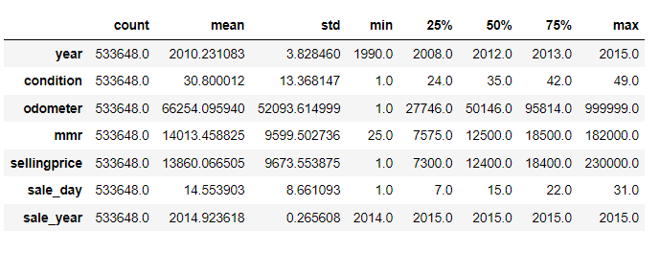
Descriptive Analysis of Numerical Data
This summary provides a snapshot of the central tendencies, variability, and range of the key variables in the dataset.

Slide 5
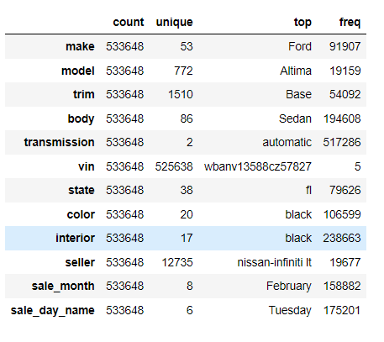
Descriptive Analysis of Categorical Data
This summary provides an overview of the most frequent values and their occurrences for each categorical variable in the dataset.

Slide 6
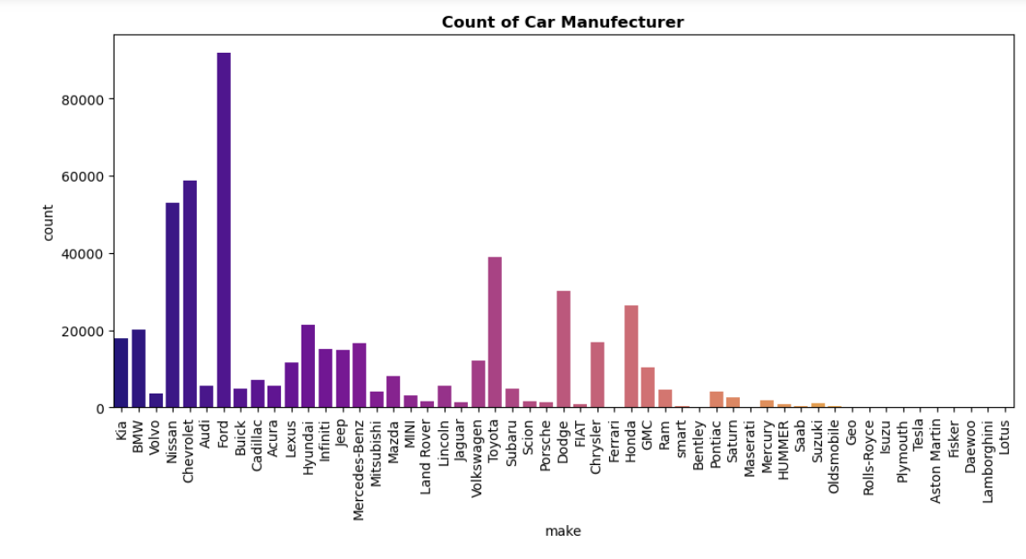
Count of car Manufacturer
🔍 Inference :
The top five car manufacturers in the dataset are Ford (91,907 entries), Chevrolet (58,817), Nissan (53,085), Toyota (38,991), and Dodge (30,100). Ford leads significantly, indicating the highest representation, while Chevrolet and Nissan also show strong presence. Toyota and Dodge follow, reflecting their notable but lesser representation. This distribution highlights Ford's dominance and the competitive standing of the other brands in the market.

Slide 7
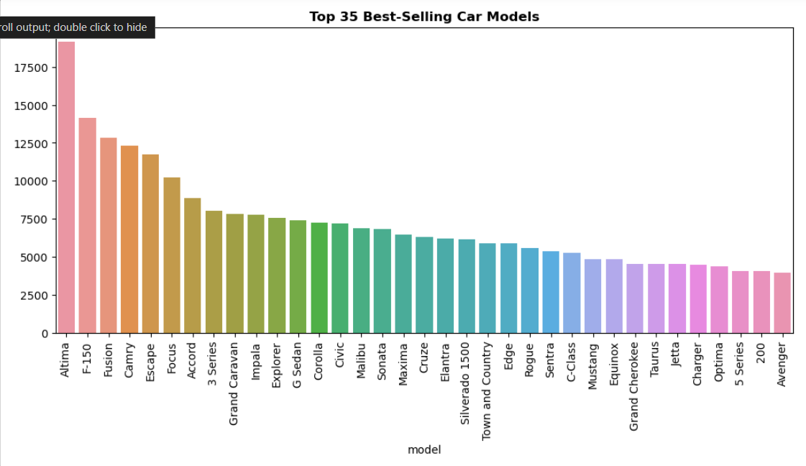
Best Selling Car Model
🔍 Inference :
The Altima is the top seller, leading by a significant margin. The F-150 follows as a strong second, with the Fusion, Camry, and Escape also showing notable sales figures, reflecting their strong market positions.

Slide 8
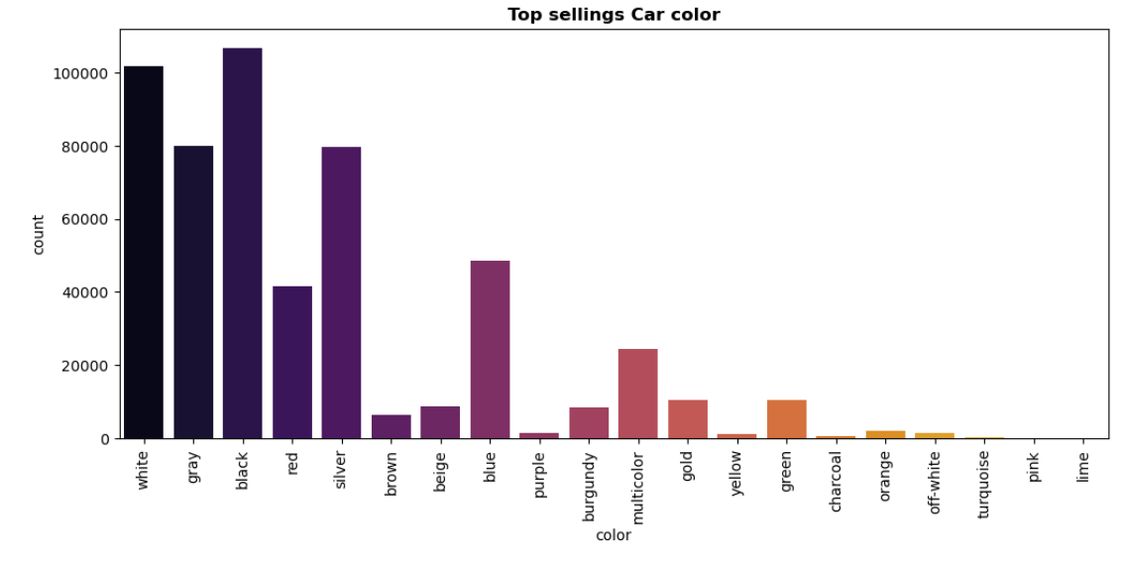
Top Selling Car Color
🔍 Inference :
The top-selling car colors are black, white, gray, silver, and blue. Black leads the market, followed by white, with gray and silver also showing strong popularity. Blue, while less prevalent, remains a notable choice among car buyers

Slide 9
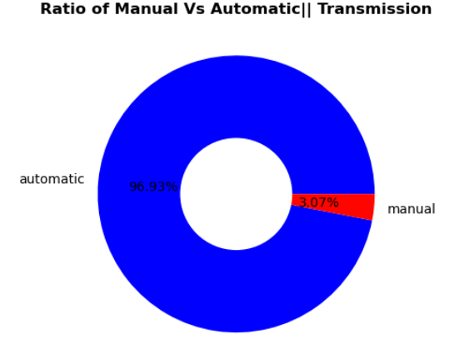
Ratio of Manual and Automatic
🔍 Inference :
In the transmission column, the data reveals that manual transmissions account for only 3% of the vehicles, while automatic transmissions dominate at 97%.

Slide 10
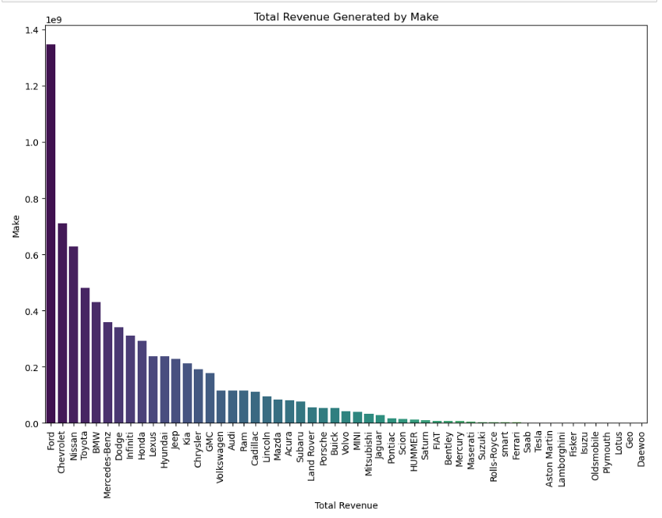
Total Revenue
🔍 Inference :
Ford generates the highest total revenue, amounting to approximately 1.35 billion, far surpassing other makes. Chevrolet and Nissan follow with revenues of about 711 million and 628 million, respectively. Toyota and BMW also contribute significantly, with revenues of 482 million and 431 million.
Other notable makes include Mercedes-Benz and Dodge, generating 360 million and 340 million, respectively. Brands such as Infiniti, Honda, and Lexus have revenues in the range of 238 million to 311 million.
In contrast, luxury and niche brands like Ferrari, Rolls-Royce, and Lamborghini show much lower revenue figures, ranging from 450,000 to 2.4 million. This data indicates a strong revenue concentration among a few leading brands, with a sharp decline as we move towards less common or luxury vehicles

Slide 11
Insights
Best-Selling Day: 📅 Tuesday tops the sales charts with 175,201 vehicles sold, making it the most favorable day for sales. Wednesday and Monday follow with 140,338 and 127,518 vehicles sold, respectively, while sales drop significantly towards the weekend, with Friday having the lowest sales at 9,774.
Best-Selling Month: 📅 February leads in car sales with 158,882 vehicles sold, followed by January with 137,293 vehicles. Sales peak early in the year and decrease notably through the months, with April and July showing the lowest figures.
Transmission Types: 🚗 Automatic transmissions dominate with 97% of the vehicles, while manual transmissions are much less common, representing only 3%. This indicates a strong preference for automatic transmissions in the dataset.
Condition Distribution: 🚗 The condition column reveals a high concentration of vehicles in condition code 19 (40,399 vehicles). Other frequently occurring conditions include 35, 37, and 44, while conditions like 12 and 13 are much less common, indicating a concentration in average conditions with fewer extreme cases.
State-Wise Sales: 🌎 Florida leads with 79,626 vehicles sold, followed by California with 69,636. The lowest sales are seen in Oklahoma and Nova Scotia, with fewer than 100 vehicles sold, showing a strong regional variation in car sales.
Total Revenue by Make: 💰 Ford generates the highest total revenue at approximately 1.35 billion, far ahead of Chevrolet and Nissan with 711 million and 628 million, respectively. Luxury brands like Ferrari and Rolls-Royce have much lower revenue figures, indicating a significant concentration of revenue among leading makes.

